Slide 1
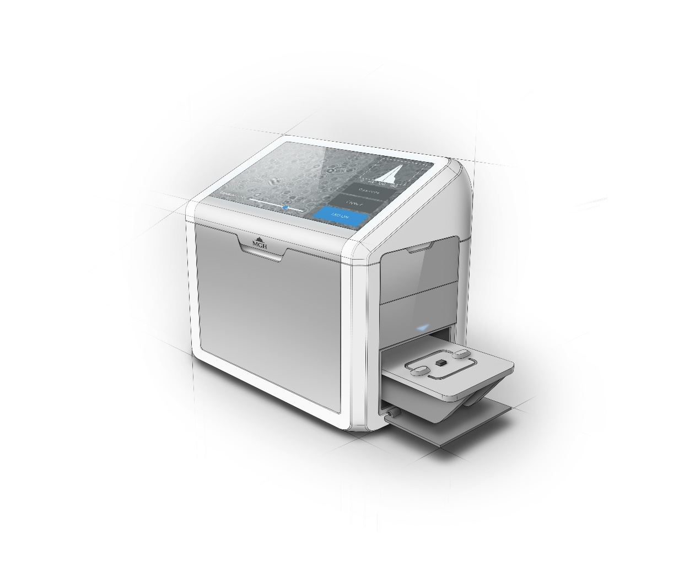
Deep Learning of Optical Diffraction
Ismail Degani
6.874 Final Presentation

Slide 2
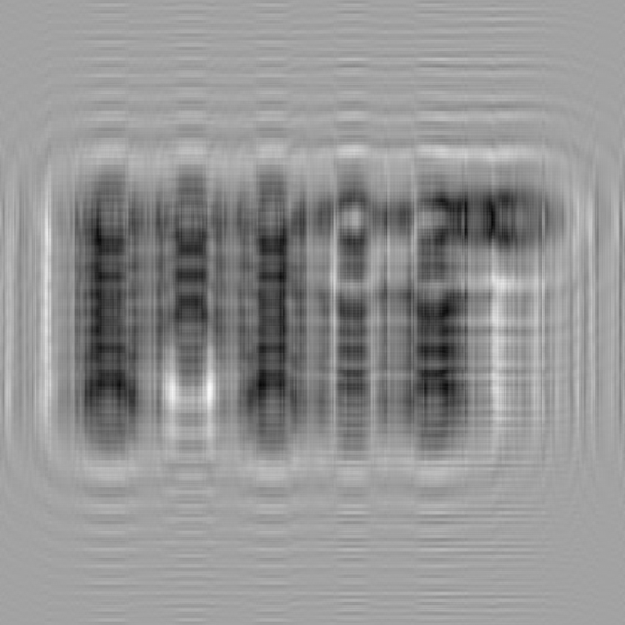
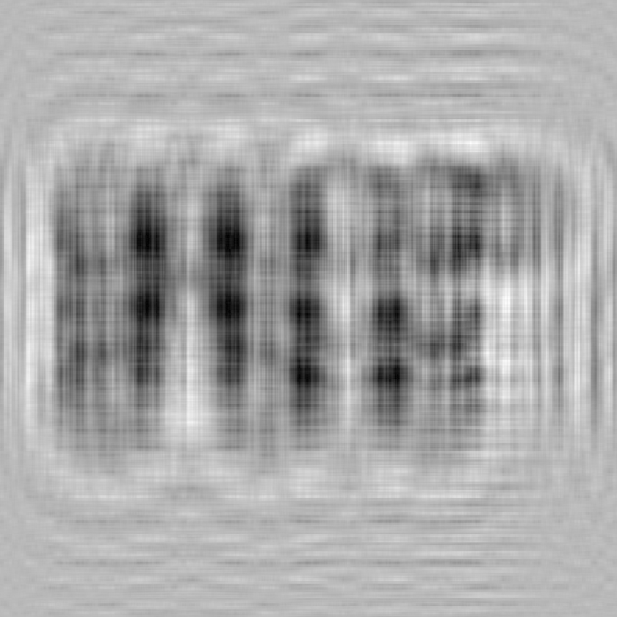
Can a machine learn to read this?

Slide 3

Can a machine learn to read this?

Slide 4
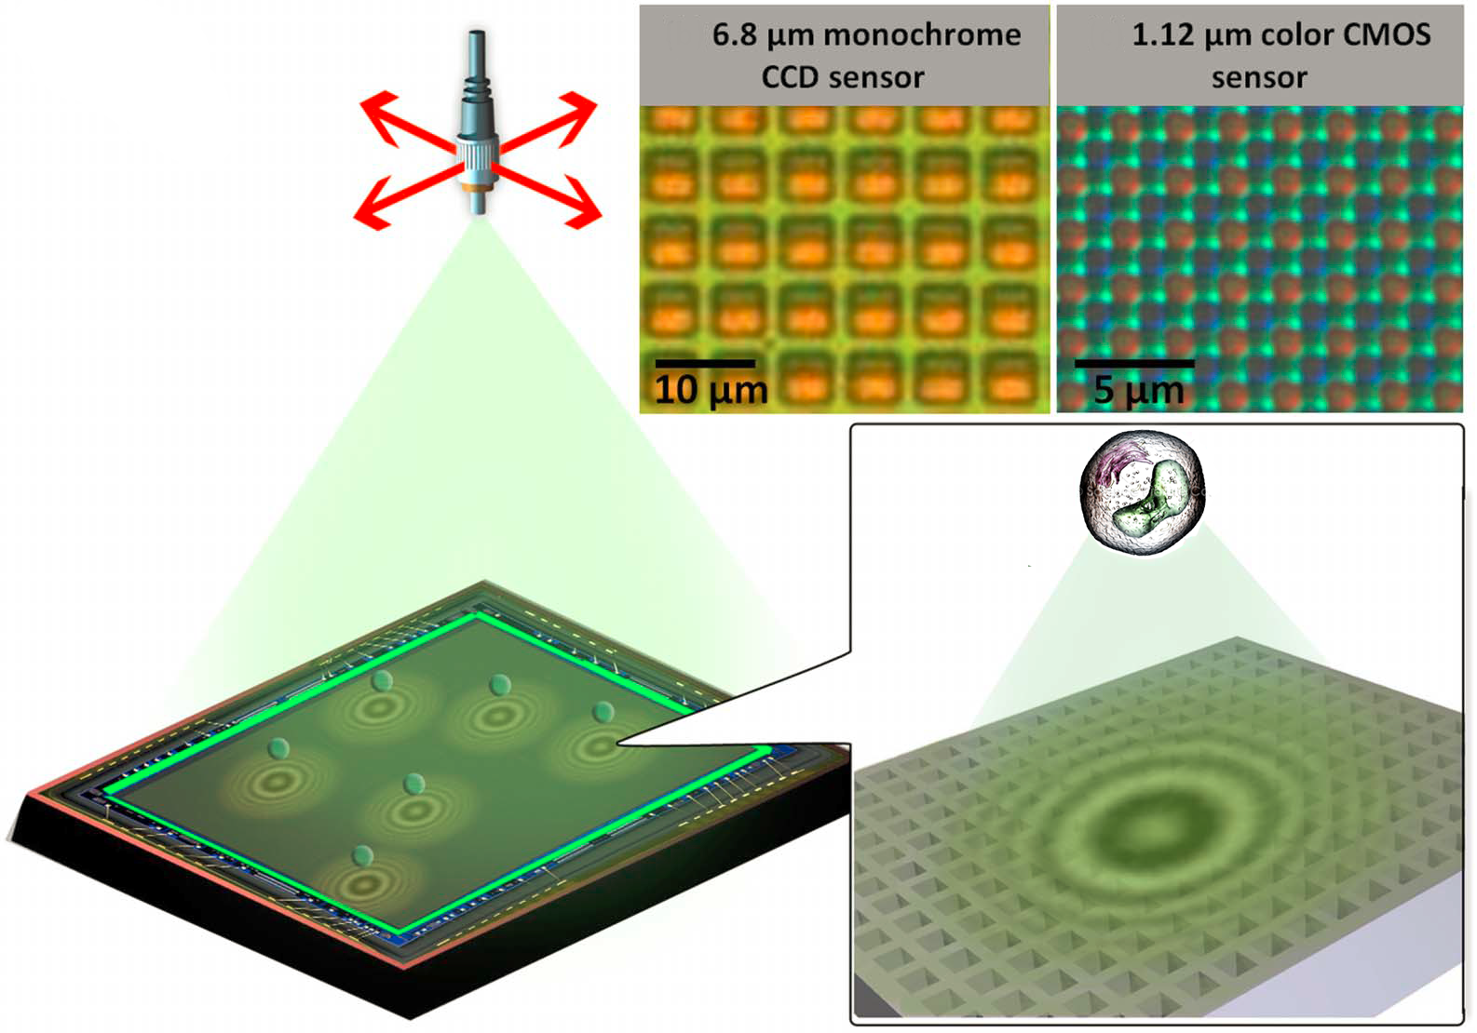
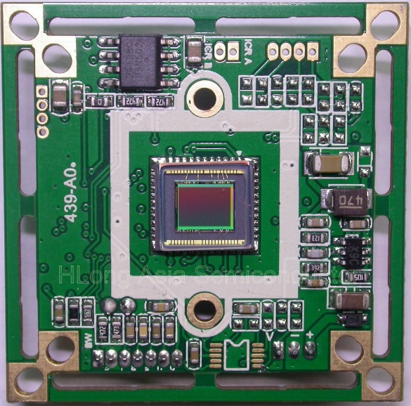
Digital Holography
$7.00 CMOS SENSOR
$0.50 UV LED
Greenbaum, A., Luo, W., Khademhosseinieh, B., Su, T., Coskun, A. F., & Ozcan, A. (2013). Increased space-bandwidth product in pixel super-resolved lensfree on-chip microscopy. Scientific Reports, 3(1). doi:10.1038/srep01717

Slide 5
Digital Holography: A “Software” Lens

Slide 6
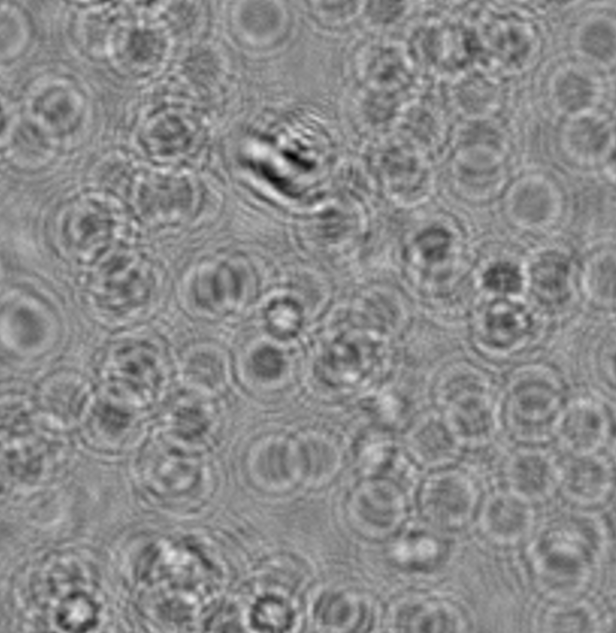
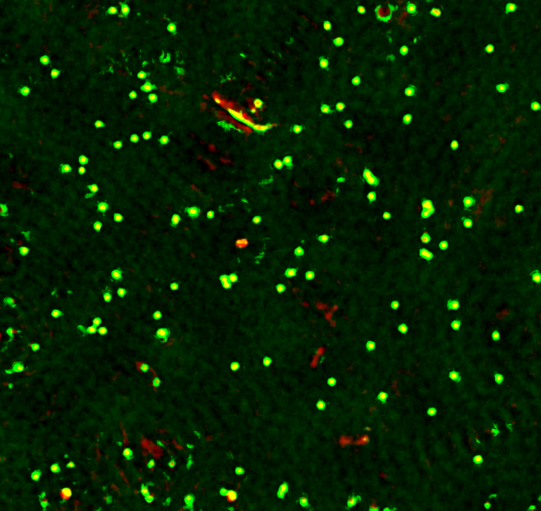
Target Labeled Dataset: B-Cell Lymphoma
Eight 5-MP images
~50,000 cells each
Labeled using Frequency based Reconstruction Technique

Slide 7
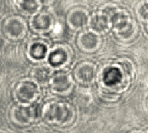
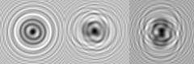
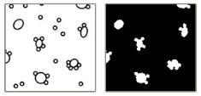
Strategy
Lymphoma Dataset
Simulate data
Full control
Make Incremental Progress
Solve small problems with confidence
Break problem into:
Diffraction Classification
Image Segmentation
Isolated Diffraction
Un-diffracted segmentation

Slide 8
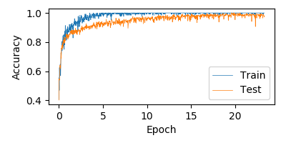
1) Repurpose the Canonical MNIST CNN
6 Representative classes
Unbound: 50%
1-5 Beads: 50%
60,000 Training Samples
10,000 Test Samples
40x40 pixels, 5-7um cells
Accuracy: 97.61%

Slide 9
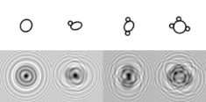
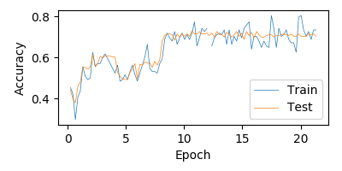
2) Diffract Dataset and Re-Train CNN Classifier
Accuracy: 75-80%
Changed many network parameters, no success
Numerical Instability

Slide 10
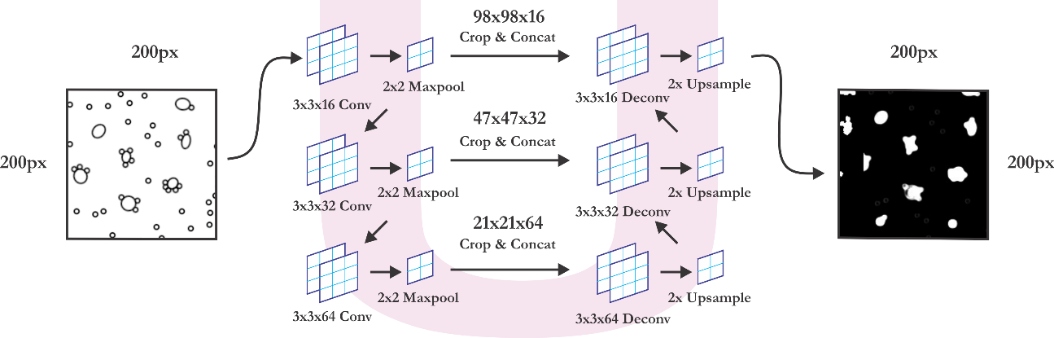
3) Segmentation: 3-Layer U-NET Architecture

Slide 11
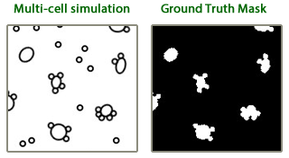
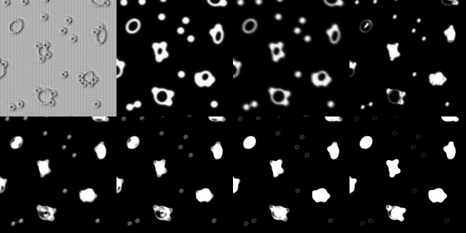
3) Segmentation: 3-Layer U-NET Architecture
Epoch 0 | Epoch 2 | Epoch 4 | Epoch 6
Epoch 8 | Epoch 10 | Epoch 12 | Epoch 14

Slide 12
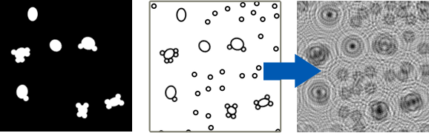
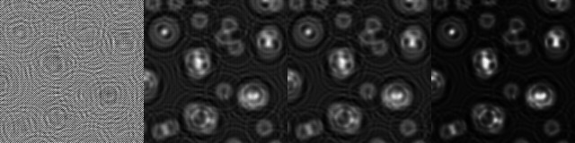
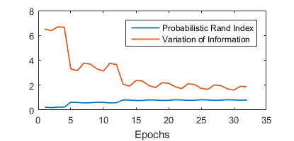
4) Diffraction Segmentation
Epoch 0
Epoch 15
Wave suppression
Center Activation

Slide 13
Conclusions / Lessons Learned
Fully Convolutional CNN U-Net is great at image segmentation
Give it a try!
Written in Python/Tensorflow
Full Source on Github https://github.com/jakeret/tf_unet
Diffraction results are promising, CNN does appear to have the ability read diffraction patterns
Further analysis needed to confirm this

Slide 14

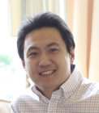
Thank You Very Much!
6.874 Course Staff:
Jonas Mueller, Michael Sun, Haoyang Zeng and Prof. Gifford
Center for Systems Biology, MGH
PI Hahko Lee
PI Hyungsoon Im
Questions?

Slide 15
Appendix

Slide 16

D3: Clinical Trial and Commercialization 2018
Low Cost
Less calibration
Field of View
100,000 Cells
24mm²
$7.00 CMOS SENSOR
$0.50 UV LED

Slide 17
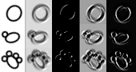
Rotational Invariance?

Slide 18
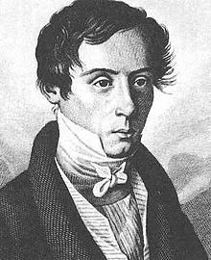
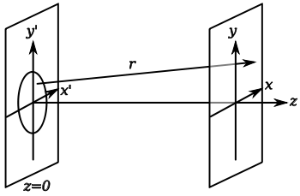
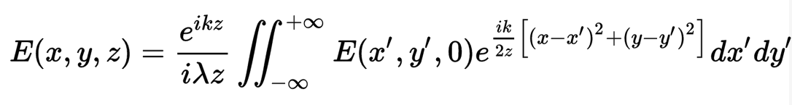
Diffraction is well understood…
Augustin-Jean Fresnel
1788-1827
https://en.wikipedia.org/wiki/Fresnel_diffraction

Slide 19
Diffraction is well understood…
Z=0

Slide 20

Diffraction is well understood…
Z=10μm

Slide 21
Diffraction is well understood…
Z=20μm

Slide 22
Diffraction is well understood…

